Slide 1
DISCRETE MATH MID

Slide 2
SET THEORY
A set is a collection of objects called elements.
$\{1, 2, 3\} = A$ Copy
Sets can be finite or infinite $A=\{1,2,3,4,5,6,7,8,9\}$ $Z=\{1,2,3,4,...\}$
Additional Points:
Repeated elements are listed once $\{a,b,a,c,b,a\}=\{a,b,c\}$
There is NO ORDER in a set. $\{3,2,1\}=\{1,2,3\}$ $=\{2,1,3\}$
Common Sets
Natural Numbers
$$N=\{0,1,2,3,...\}$$
$$OR$$
$$\{1,2,3,...\}$$
Integers
$$Z=\{...,−2,−1,0,1,2,...\}$$
Rational Numbers
$$Q=\{\frac{1}{1},\frac{1}{2},\frac{1}{3},\frac{2}{3}\}$$
Elements and Cardinality
Cardinality (size)
Let $C=\{yellow,blue,red\}$
Yellow is an element of C
$$Yellow∈C$$
Green is not an element of C
$$Green∉C$$
The cardinality(size) of C is 3
$$\left|C\right|=3$$
The Empty Set
The Empty Set symbol:
$ϕ=\{\}$
It is the only set that has a size of 0
$\left|ϕ\right|=0$
but, What is the size of a set containing the Empty Set ?
$\left|\{⌀\}\right|=1$
The answer is 1, because the BIG SET has 1 element.
BUT, it's different to the set that contains NOTHING.
$\left|\{\}\right|=0$
Set-Builder Notation
$⋅Q=\{…,1/1,1/2,1/3,2/3,…\}$
$$=\left\{\frac{m}{n}∣m,n∈Z,n≠0\right\}$$
$2Z=\{…,−4,−2,0,2,4,…\}$
$$\left\{2n∣\begin{matrix}n∈Z\end{matrix}\right\}$$
Desk = {drink, laptop, microphone}
$$=\{x∣x is on my desk\}$$
Example:
List the elements of D.
$$1,2,3,4,5$$
What is the cardinality of D?
$$\left|D\right|=5$$
What is the cardinality of

Slide 3
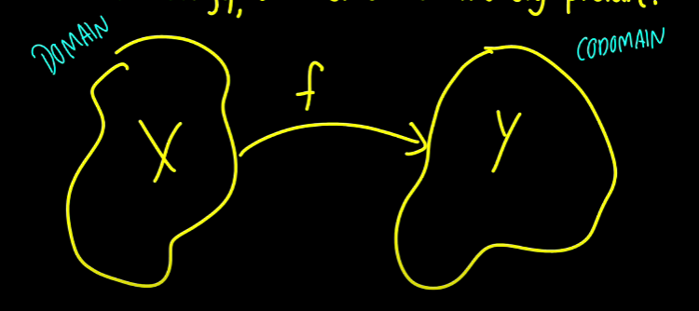
RELATIONS and FUNCTIONS
Relations of relations
Reflexive - For all X, we have xRx or it means X is related to itself.
Symmetric - For all elements X and elements Y, if X is related to Y then Y is related to X
Transitive - For 3 elements X,Y and Z, If X is related to Y and Y is related to Z then X is also related to Z.
Functions

Slide 4
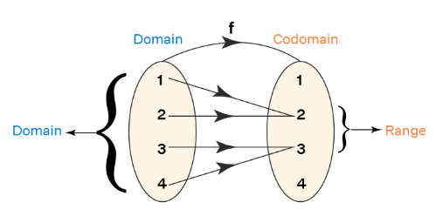
This function maps an element of X into an element of Y, Which we will call it Y1 Wherever we put the elements in X it will always be maps to Y and what we call the Y is RANGE. The REDZONE here is part of the CODOMAIN but is not part of the RANGE
Domain and Range
The domain and range are defined for a relation and they are the sets of all the x-coordinates and all the y-coordinates of ordered pairs respectively. For example, if the relation is, R = {(1, 2), (2, 2), (3, 3), (4, 3)}, then:
Domain = the set of all x-coordinates = {1, 2, 3, 4}
Range = the set of all y-coordinates = {2, 3}
We can visualize this here:
Pasted image 20221108111351.png

Slide 5
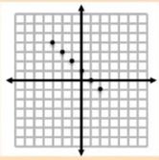
DOMAIN - all of the first values (X coordinates)
RANGE - all of the second values (Y coordinates)
CONTINUOS GRAPHS - Graphs with CONNECTED LINES or CURVES (includes values that are not integers)
DISCRETE GRAPHS - Graph that contains POINTS that are only Integers. There is not a line connecting the points.
Pasted image 20221108095315.png

Slide 6
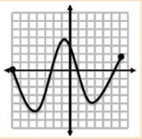
DISCRETE GRAPH
Domain: X {-3, -2, -1, 0, 1, 2}
Range: Y {4, 3, 2, 1, 0, -1}
Pasted image 20221108095506.png

Slide 7
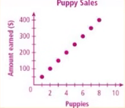
CONTINUOS GRAPH
Domain: X -7, ≤ x ≤ 6
Range: Y -5 ≤ y ≤ 4
Pasted image 20221108095806.png

Slide 8
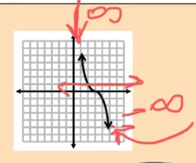
DISCRETE GRAPH
Domain: X {1 , 2, 3, ... , 9}
Range: Y {50, 100, 150, ... , 400}
Pasted image 20221108100036.png

Slide 9
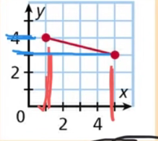
CONTINUOUS GRAPH
Domain: X All Real Numbers (ARN) or -∞ ≤ X ≤ ∞
Range: Y All Real Numbers (ARN) or -∞ ≤ Y ≤ ∞
Pasted image 20221108100506.png

Slide 10
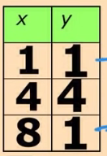
CONTINUOUS GRAPH
Domain: X 1 ≤ X ≤ 5
Range: Y 3 ≤ Y ≤ 4
Pasted image 20221108100724.png

Slide 11
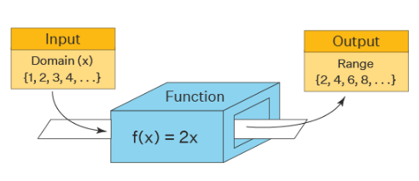
DISCRETE
Domain: X {1, 4, 8}
Range: Y {1, 4}
Domain and Range of Function
The domain and range of a function are the components of a function. The domain is the set of all the input values of a function and range is the possible output given by the function. Domain→ Function →Range. If there exists a function f: A →B such that every element of A is mapped to elements in B, then A is the domain and B is the co-domain. The image of an element 'a' under a relation R is given by 'b', where (a,b) ∈ R. The range of the function is the set of images. The domain and range of a function is denoted in general as follows: Domain(f) = {x ∈ R} and range(f)={f(x) : x ∈ domain(f)}
Pasted image 20221108111524.png

Slide 12
The domain and range of this function f(x) = 2x is given as domain D ={x ∈ N } , range R = {(y): y = 2x}
Algebra of Function
If f and g are functions, and X is an element of the domain of each function, then
$$\left(f+g\right)\left(x\right)=f\left(x\right)+g\left(x\right)$$$$\left(f−g\right)\left(x\right)=f\left(x\right)−g\left(x\right)$$$$\left(f*g\right)\left(x\right)=f\left(x\right)*g\left(x\right)$$$$\left(\frac{f}{g}\right)\left(x\right)=f\frac{x}{g\left(x\right)},g\left(x\right)≠0$$
EXAMPLES:
Addition
FORMULA : (f + g) (x) = f(x) + g(x) Example: When f(x) = x2 + 2 and g(x) = x + 1, then
(f + g)(x) = f(x) + g(x)
= x2 + 2 + x + 1
= x2 + x + 3
Subtraction
FORMULA: (f - g) (x) = f(x) - g(x) Example: When f(x) = x2 + 2 and g(x) = x + 1, then
(f - g)(x) = f(x) - g(x)
= x2 + 2 - (x + 1)
= x2 - x + 1
Multiplication
FORMULA: (f · g) (x) = f(x) · g(x) Example: When f(x) = x2 + 2 and g(x) = x + 1, then
(f · g)(x) = f(x) · g(x)
= (x2 + 2) · (x + 1)
= x3 + x2 + 2x + 2
Division
FORMULA : (f / g) (x) = f(x) / g(x), given g(x) ≠ 0
Example: When f(x) = x2 + 2 and g(x) = x + 1, then
(f / g)(x) = f(x) / g(x)
= (x2 + 2) / (x + 1) Since the domain of each of f(x) is the set of all real numbers, R; and the domain of g(x) is the set of all real numbers except -1 (as x + 1 is in the denominator, x + 1 ≠ 0 ⇒ x ≠ -1). So the domain of (f / g)(x) is R - {-1}.
Important Notes on Algebra of Functions:
For any two functions f(x) and g(x):
(f + g) (x) = f(x) + g(x)
(f - g) (x) = f(x) - g(x)
(f · g) (x) = f(x) · g(x)
(f / g) (x) = f(x) / g(x), g(x) ≠ 0
Inverse Function
Function will only Intersect the VERTICAL line once on any part of its graph. If It intersect multiple times then it is NOT A FUNCTION
The inverse of f(x) is f-1(x)
EXAMPLE: f(x) = 3x + 6

